Slide 1
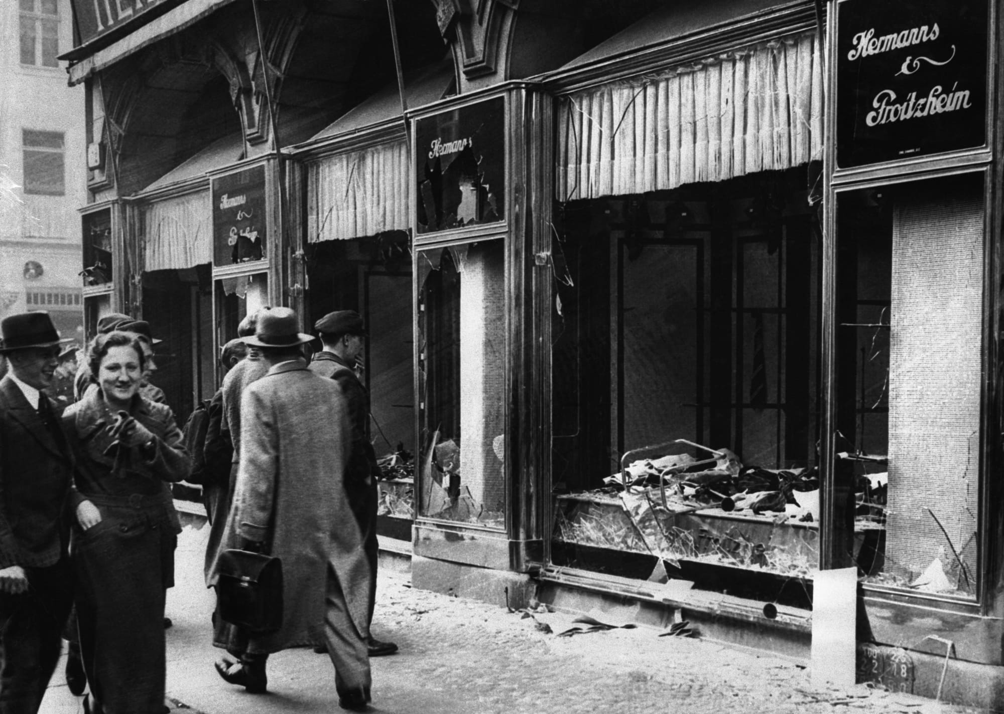
Notes:
Kristallnacht (1938)

Slide 2
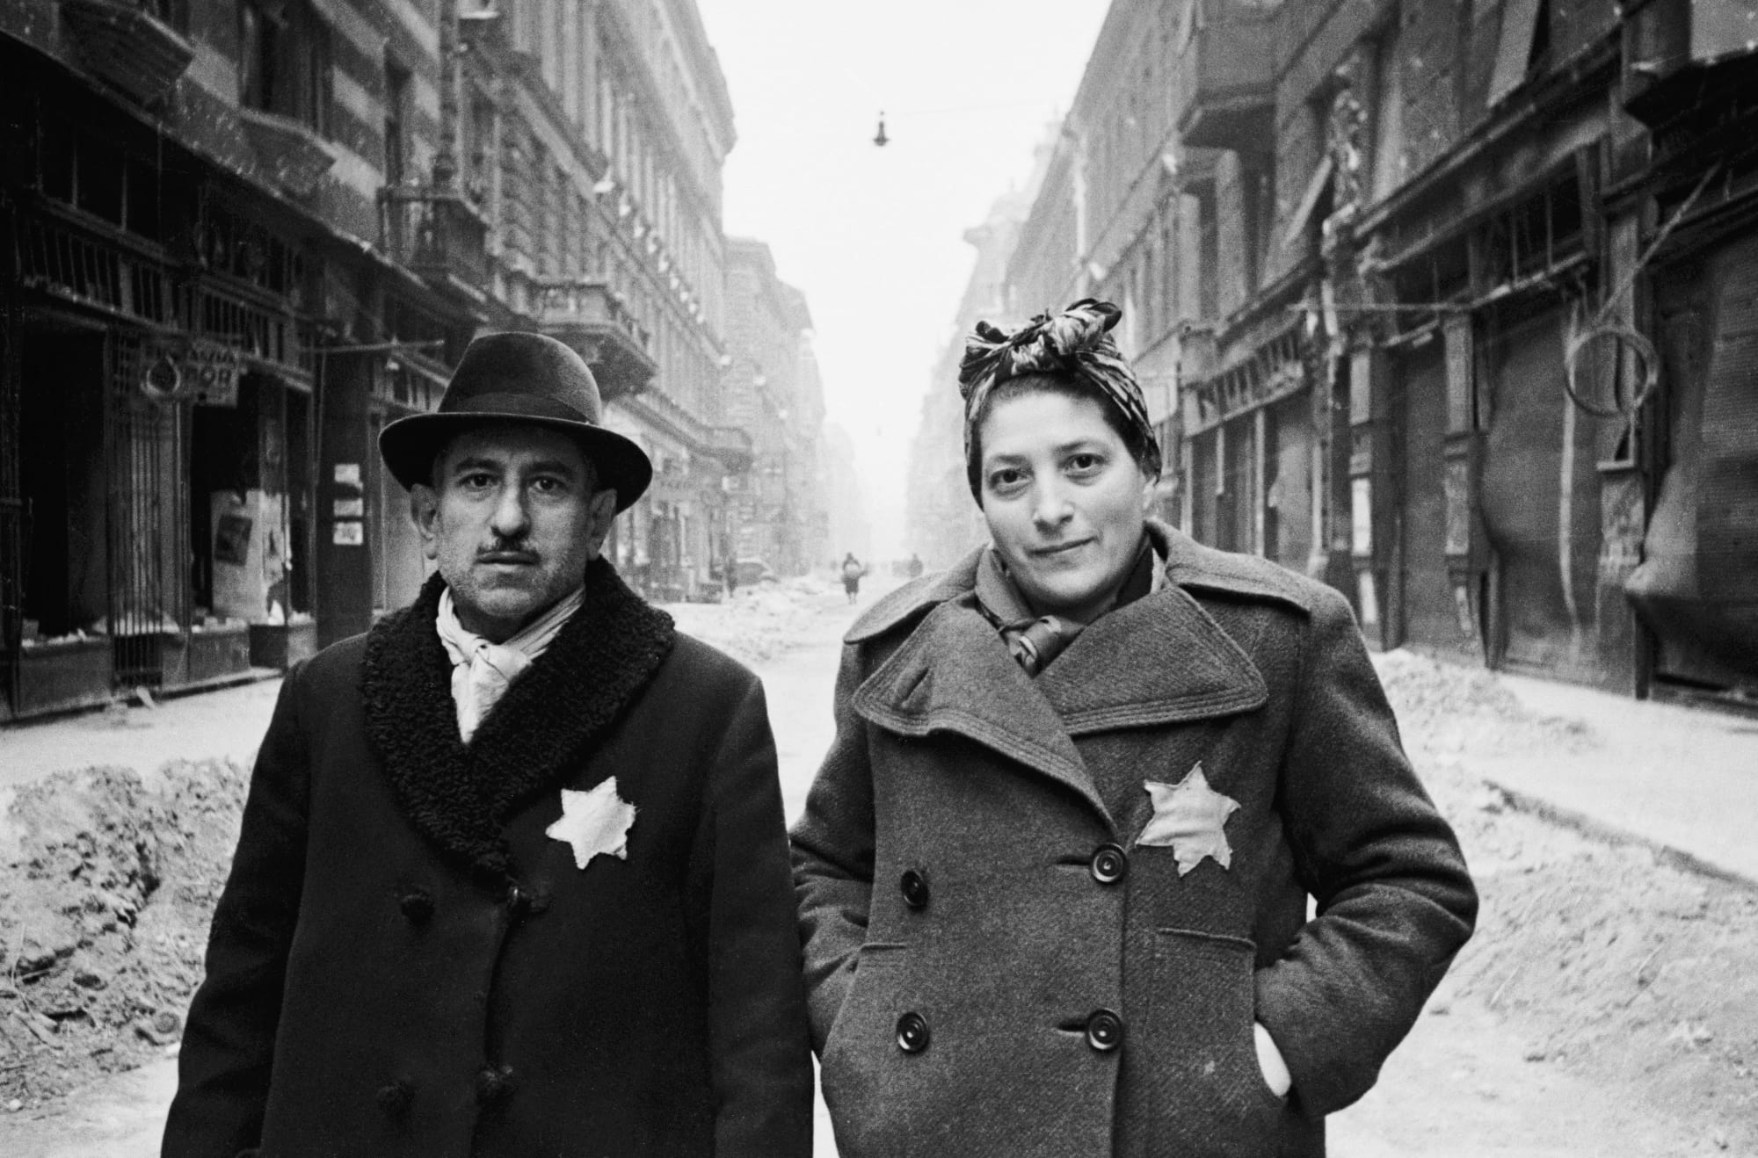
Notes:
Budapest Ghetto, Hungary (April 1944)
All Jews must wear Yellow Star

Slide 3
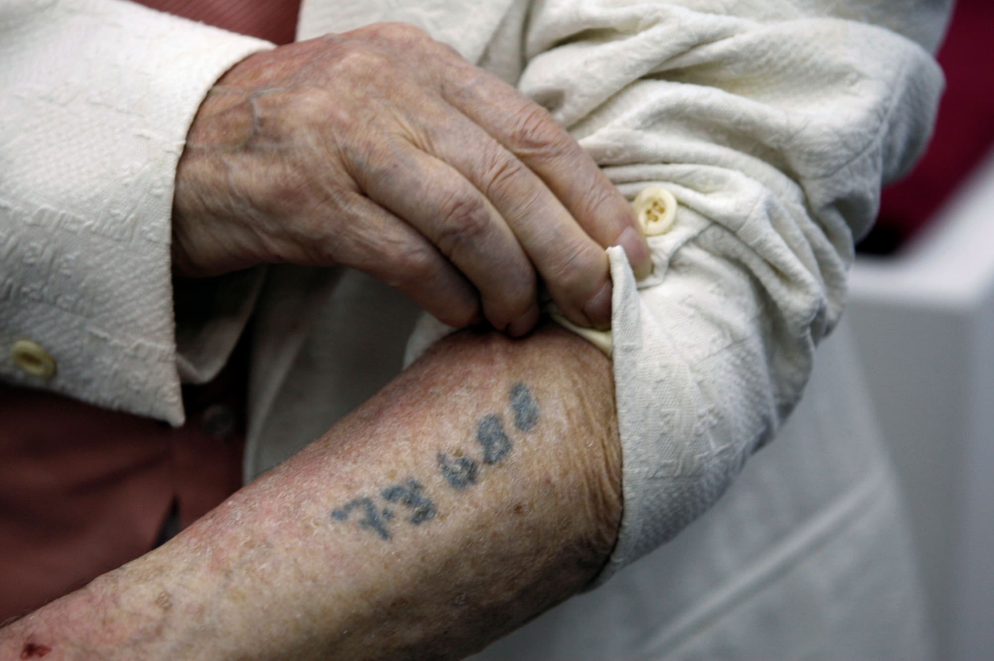
Notes:
Polish camp survivor shows his prisoner id number

Slide 4
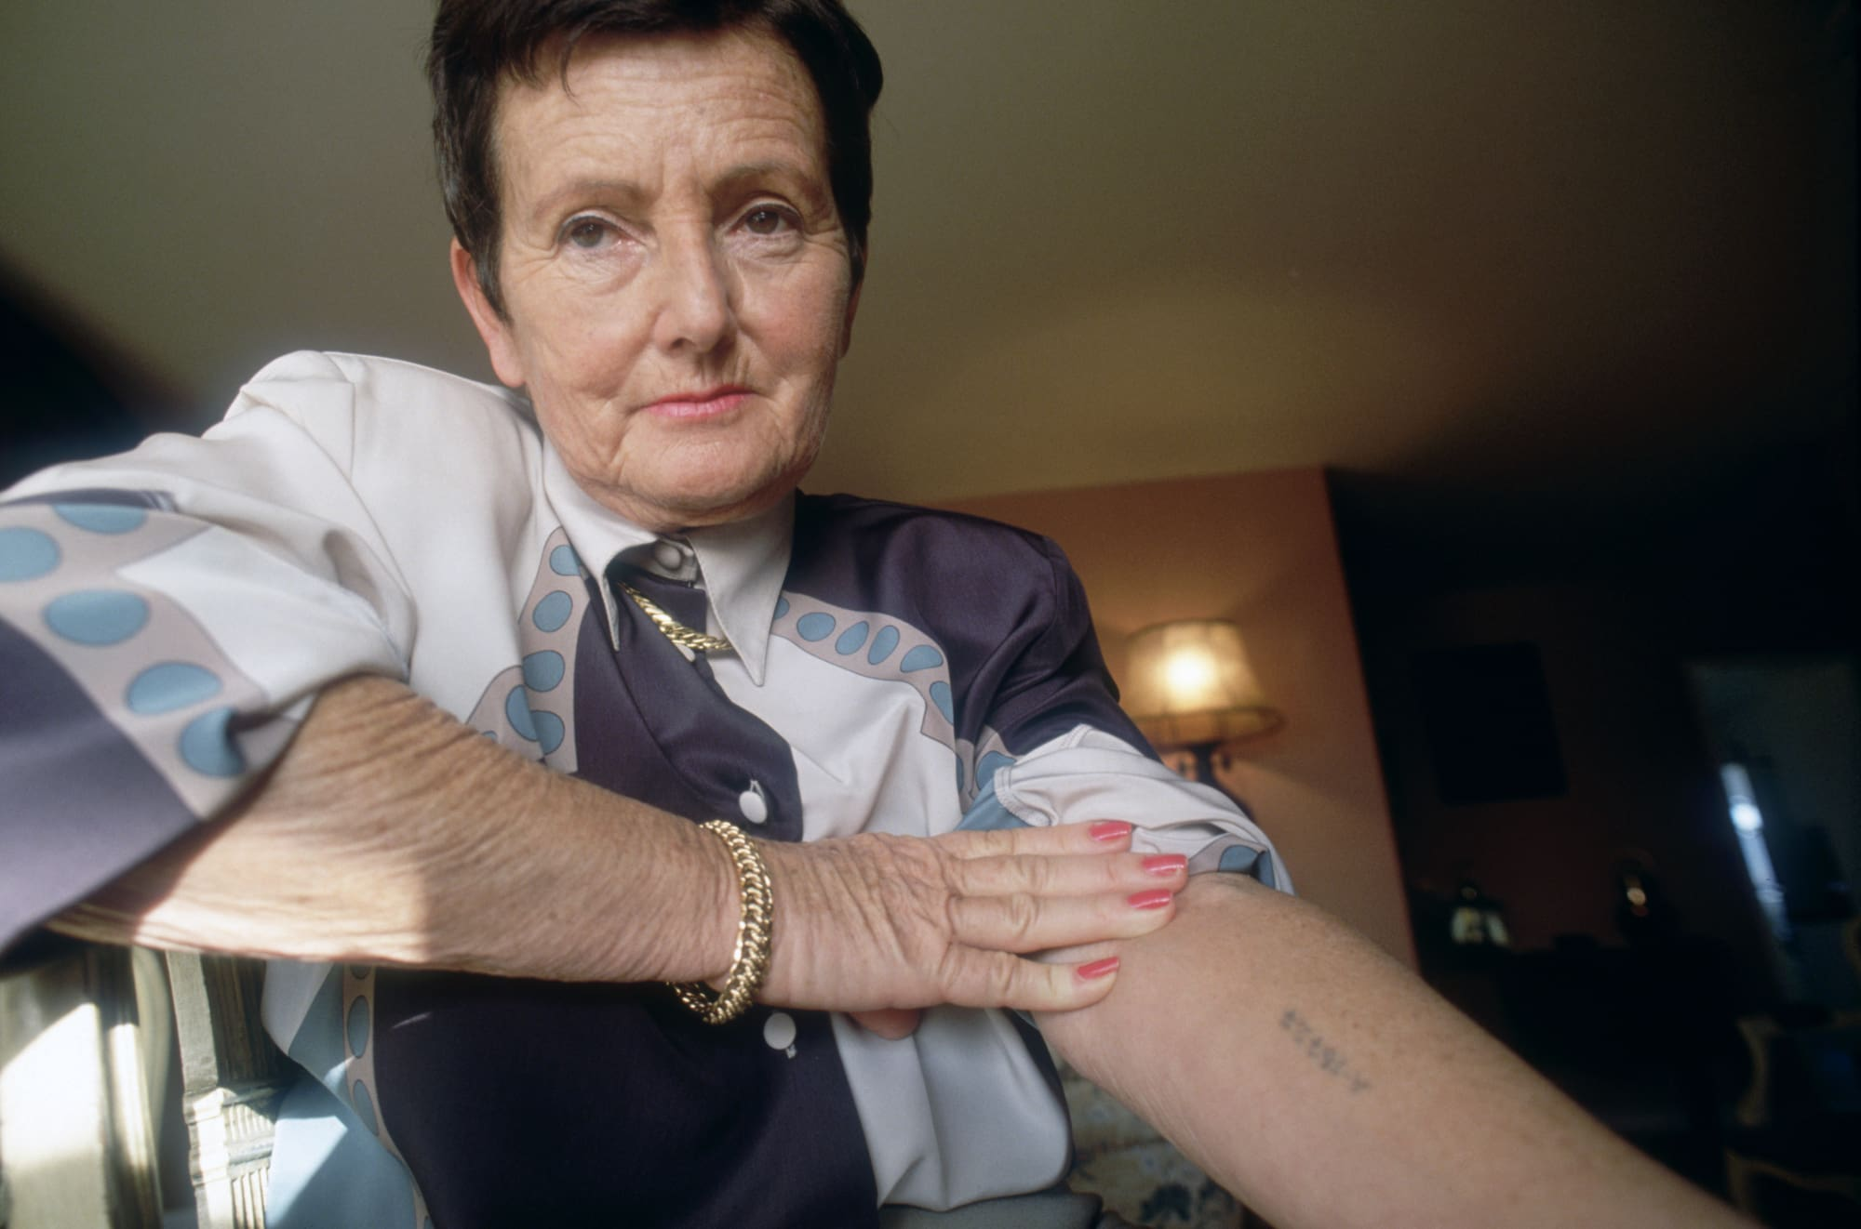
Notes:
Auschwitz survivor shows her ID

Slide 5
Notes:
Budapext Memorial Center
½ million Hungarian Jews killed

Slide 6
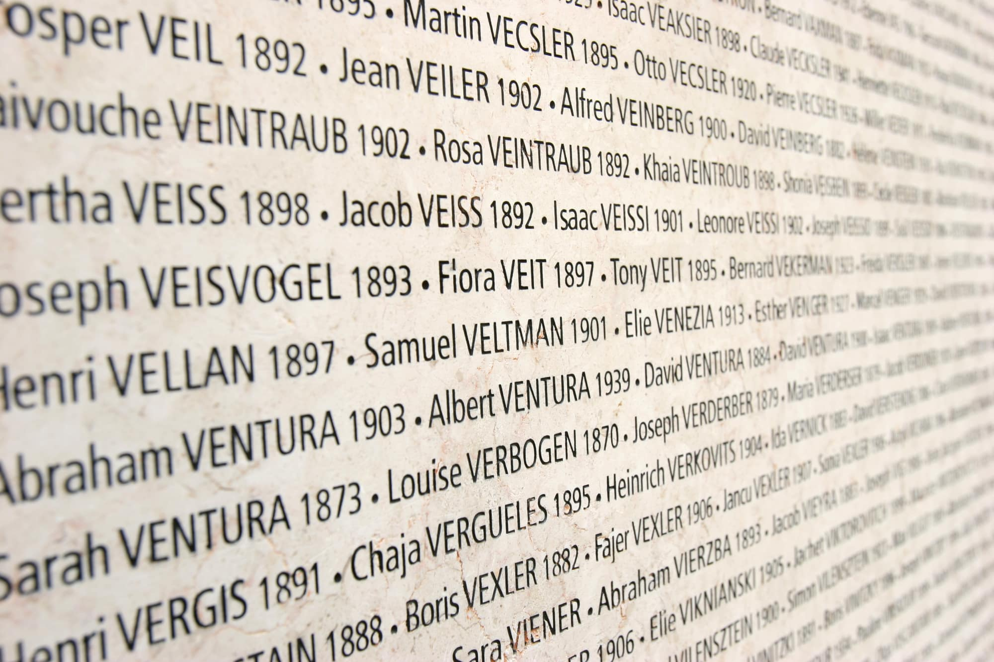
Notes:
Wall of names in Paris, 76,000 killed

Slide 7
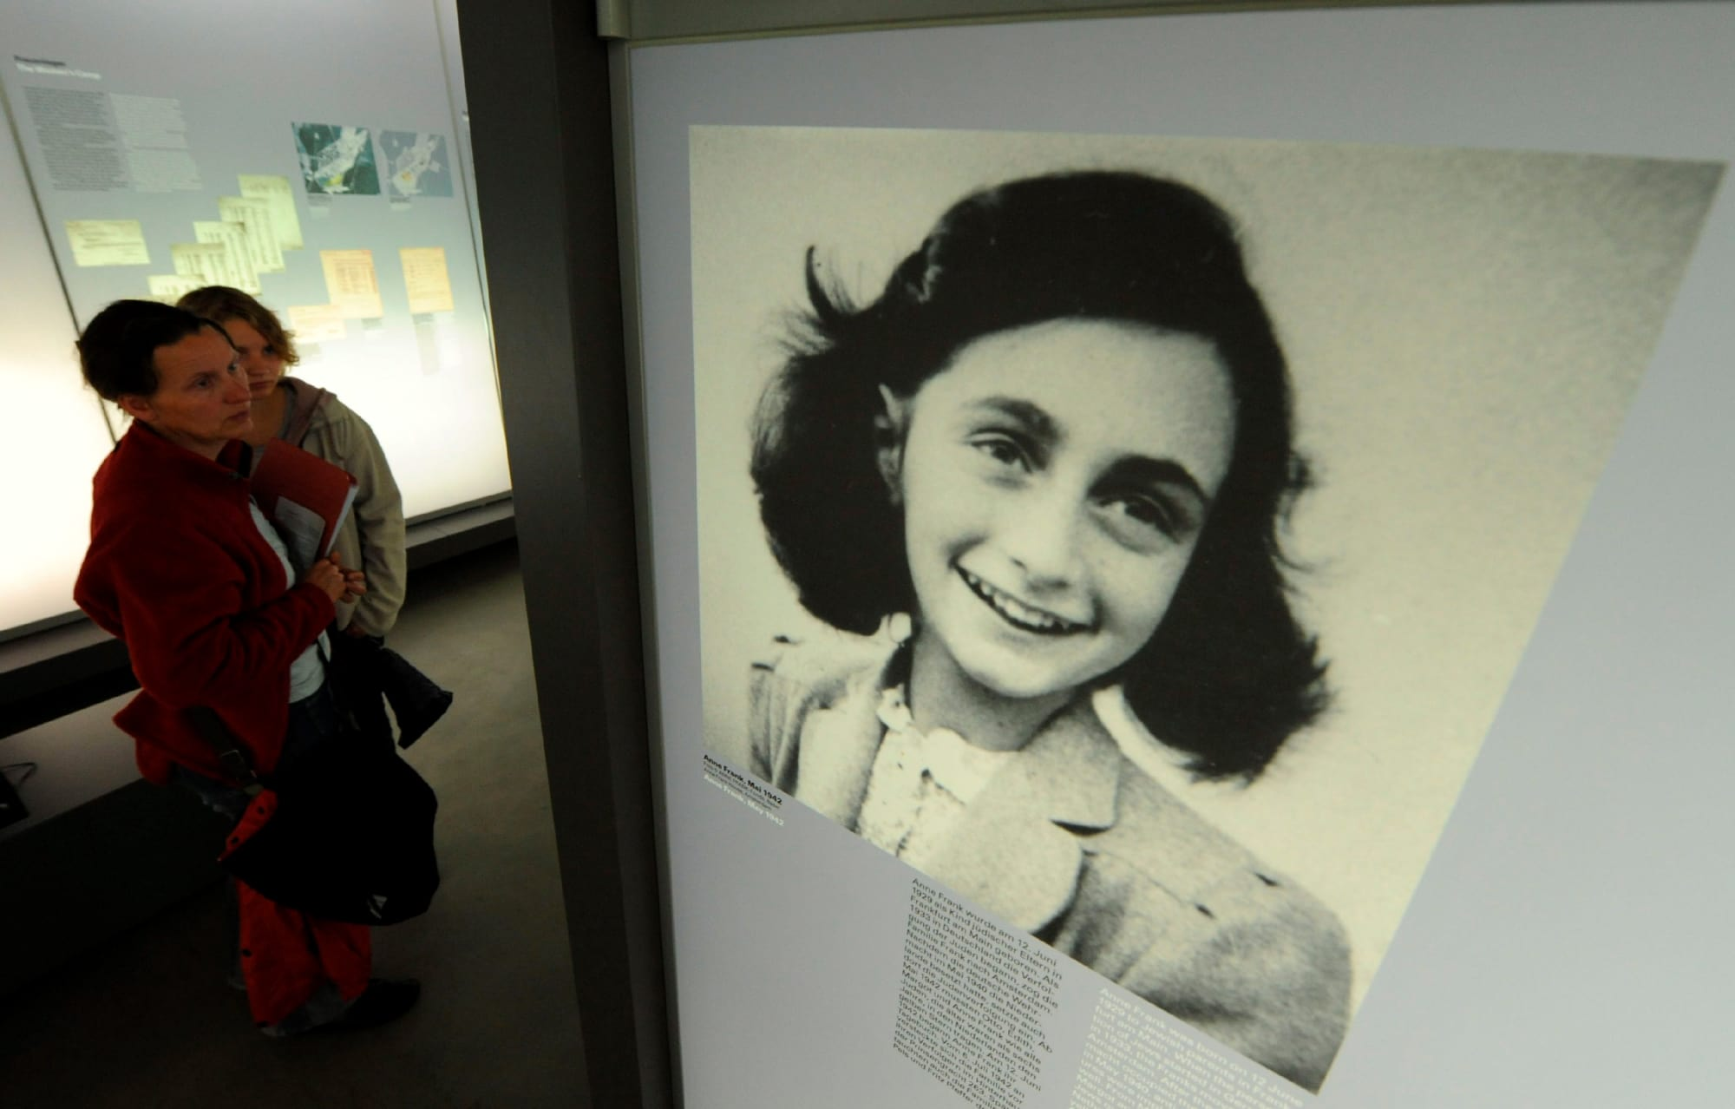
Notes:
Portrait at Bergen-Belsen museum;
Family fled from Germany
Wrote diary hiding out in Amsterdam
Family was captured Aug. 44

Slide 8
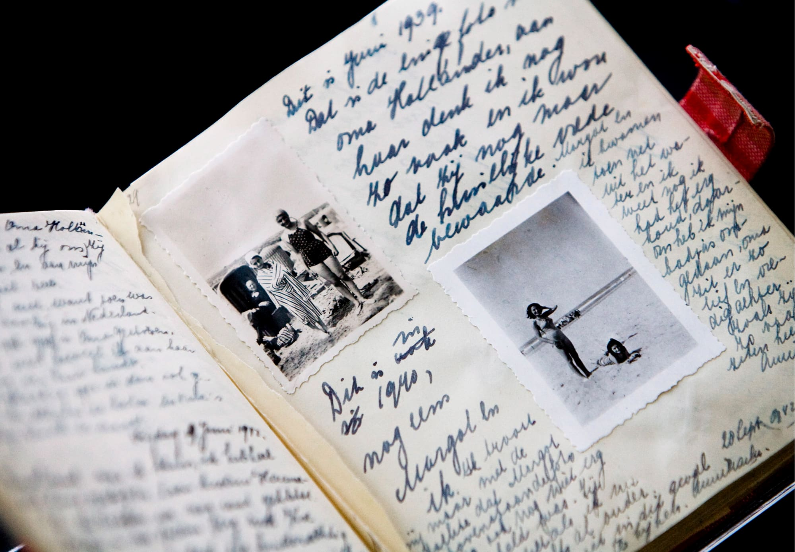
Notes:
Diary, Amsterdam Anne Franke Haus

Slide 9
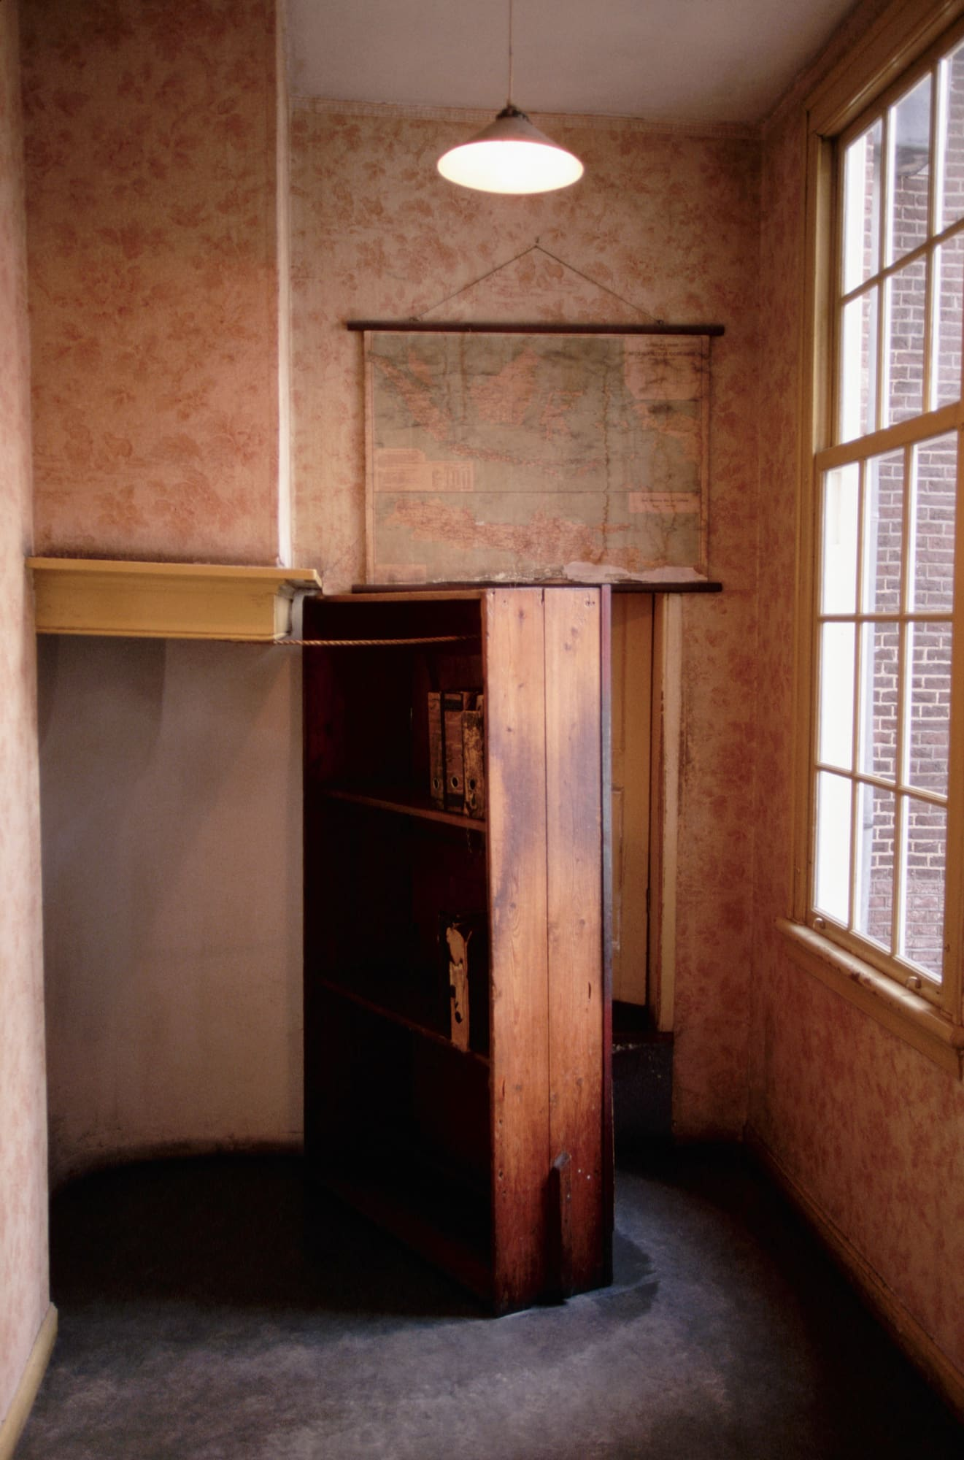
Notes:
Wooden bookshelf w/hidden door

Slide 10
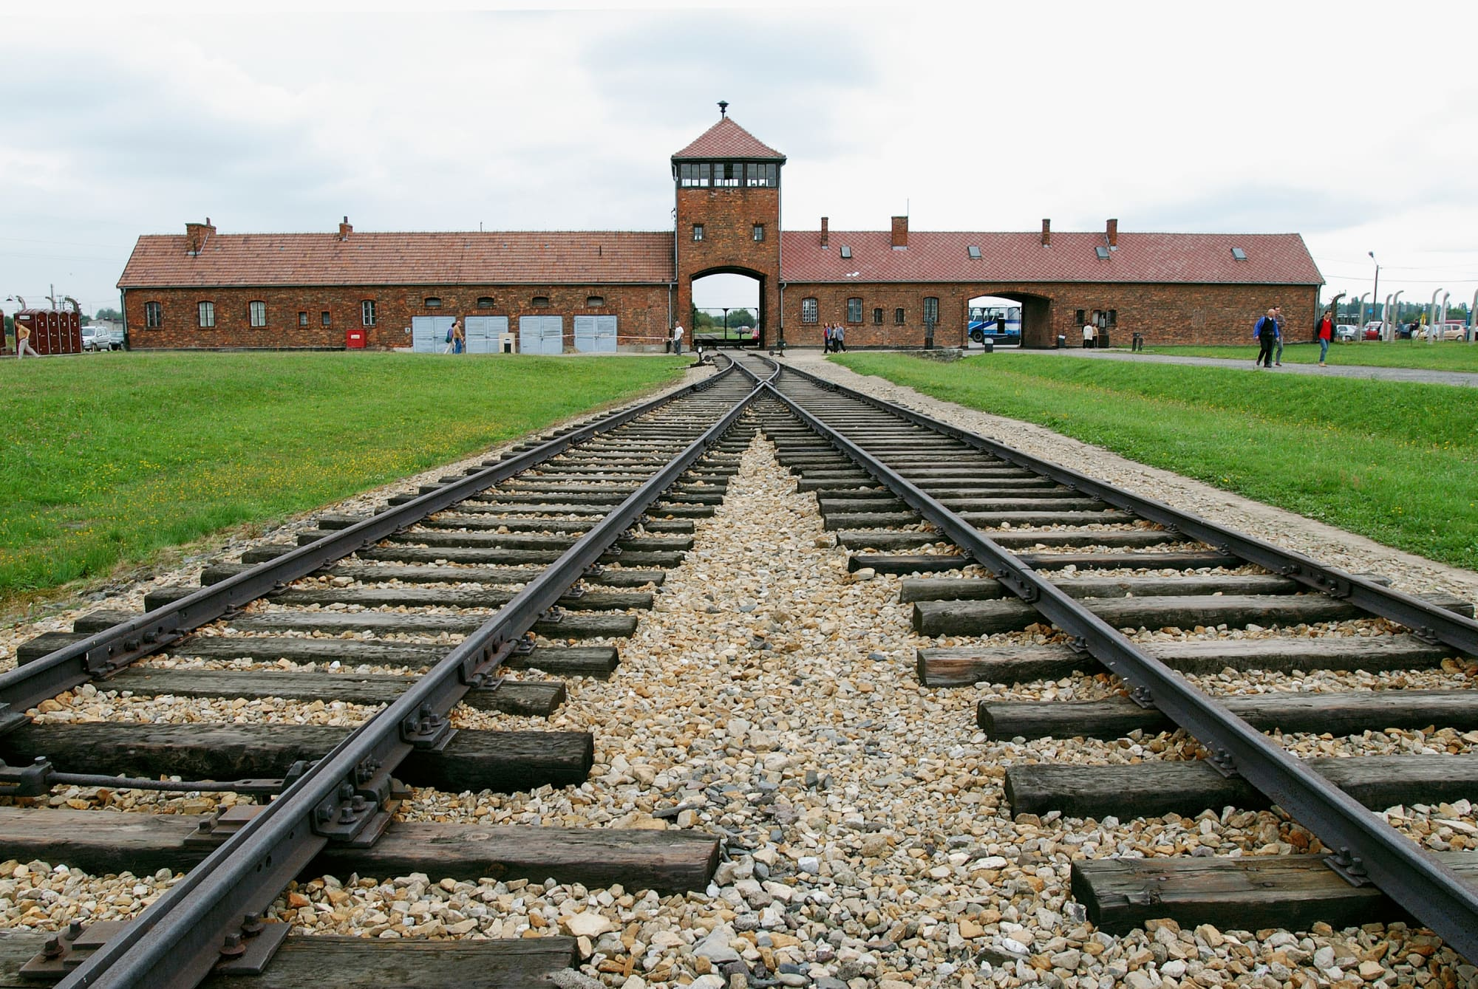
Notes:
Auschwitz, Poland
4 gas chambers
6,000 killed per day
Largest camp

Slide 11
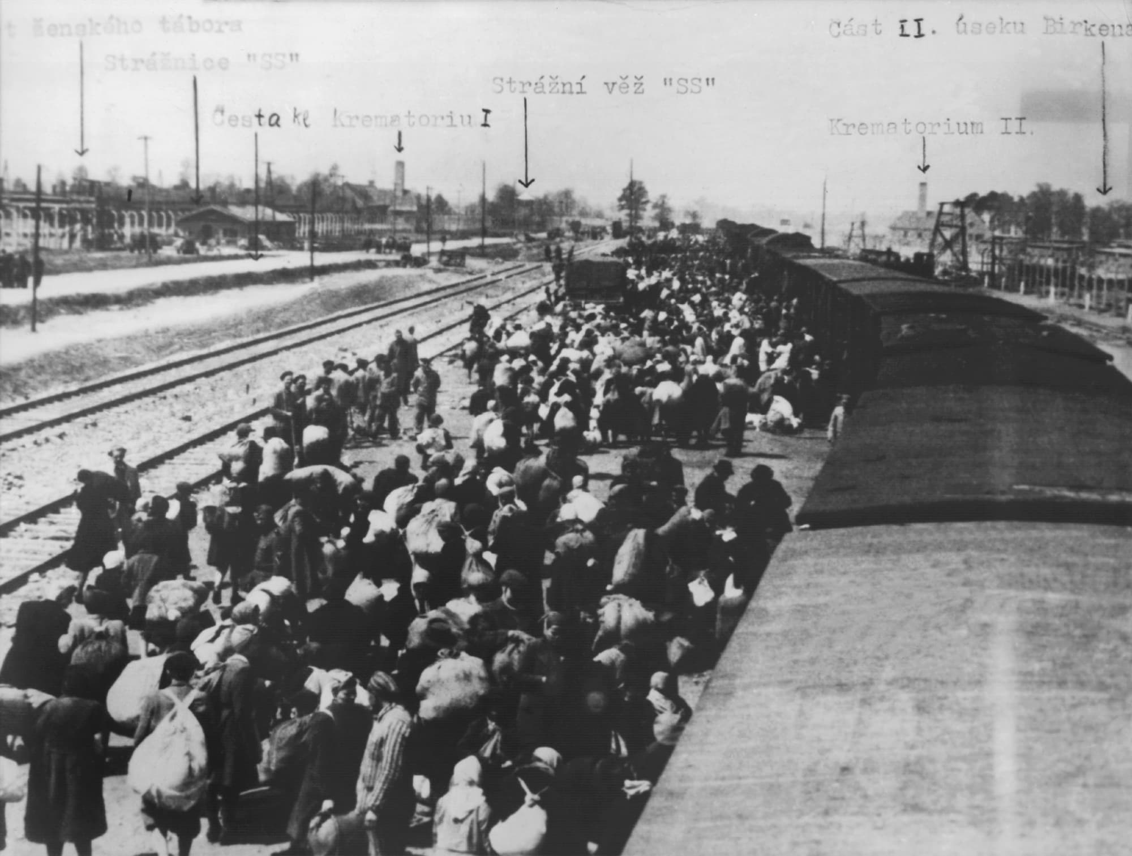
Notes:
Prisoners arriving at Auschwitz (1945)

Slide 12
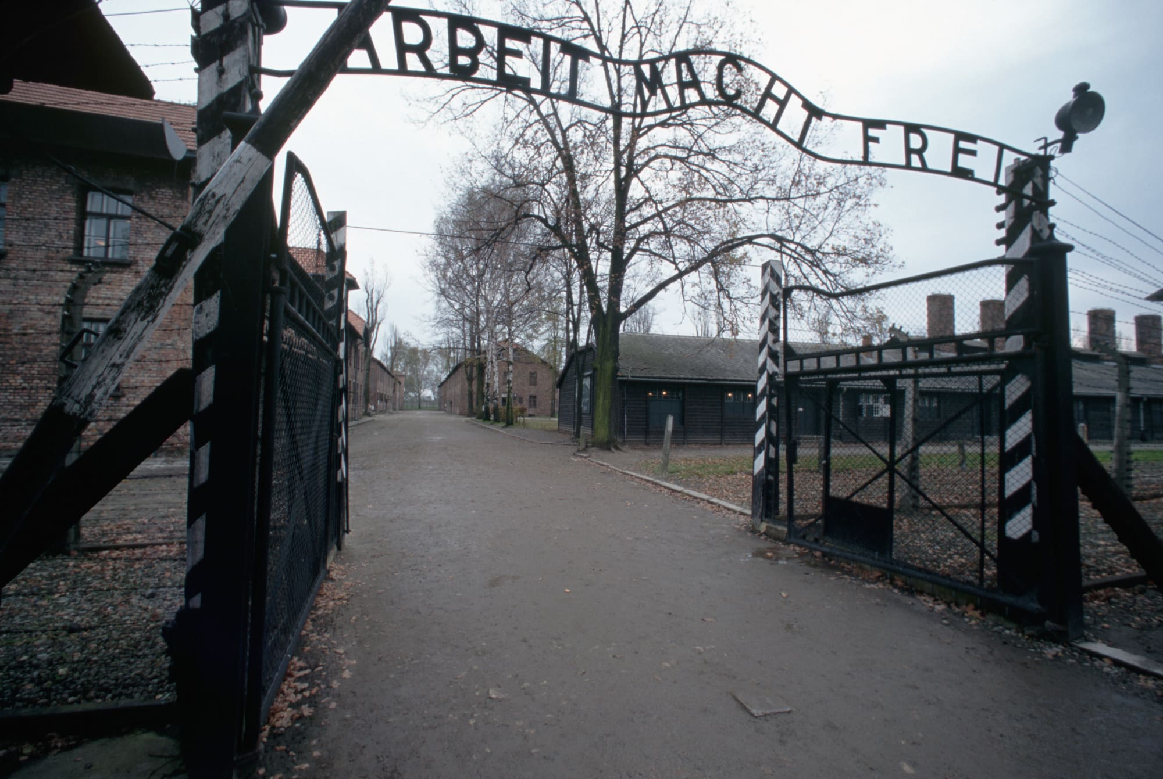
Notes:
“Work Will set You free”
In The Kingdom of Auschwitz, Otto Friedrich wrote about Rudolf Höss, regarding his decision to display the motto so prominently at the Auschwitz entrance:
He seems not to have intended it as a mockery, nor even to have intended it literally, as a false promise that those who worked to exhaustion would eventually be released, but rather as a kind of mystical declaration that self-sacrifice in the form of endless labour does in itself bring a kind of spiritual freedom.^{[14]}
The signs are prominently displayed, and were seen by all prisoners and staff—all of whom knew, suspected, or quickly learned that prisoners confined there would likely only be freed by death. The signs' psychological impact was tremendous.
Stolen 2009, returned
One at Dachau stolen 2014, returned

Slide 13
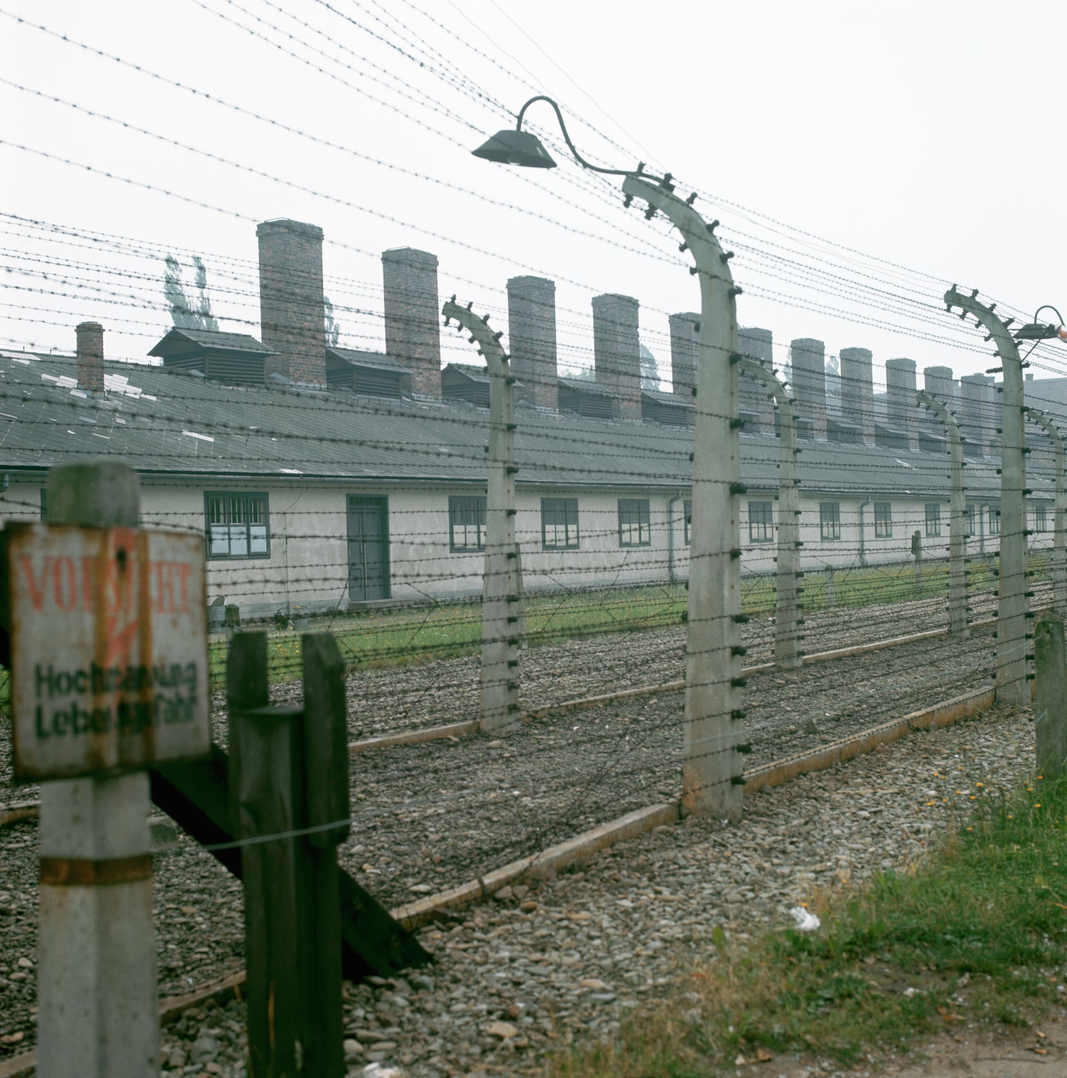
Notes:
Crematoria at Auschwitz (where dead bodies were burned)

Slide 14
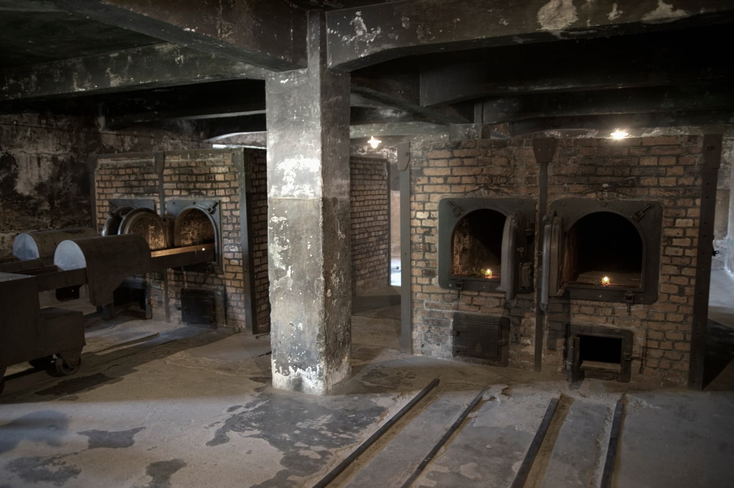
Notes:
Ovens inside the crematoria, Auschwitz

Slide 15
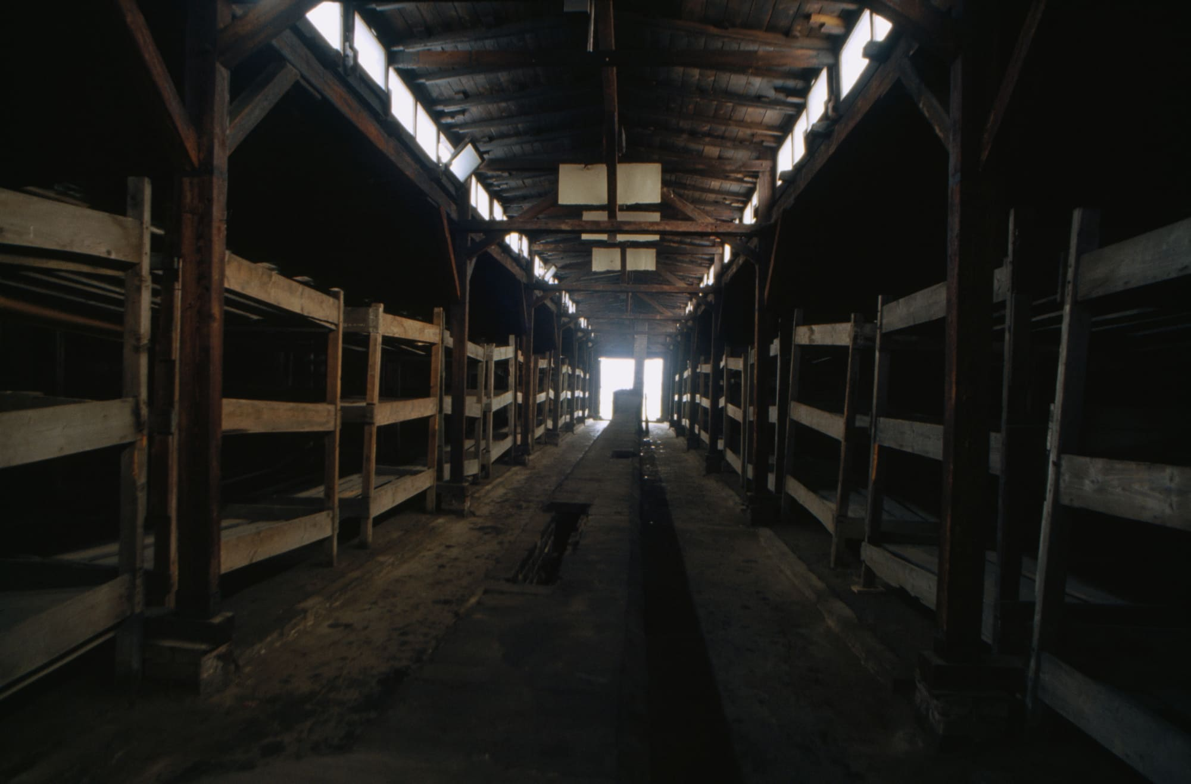
Notes:
Dormitory, Auschwitz

Slide 16
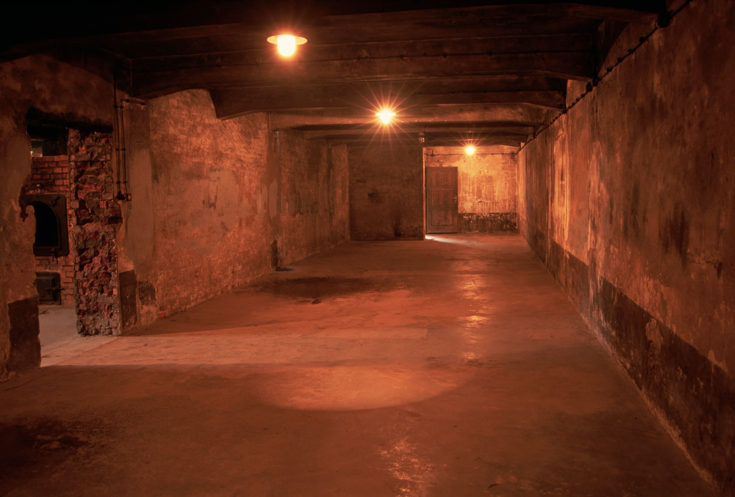
Notes:
Gas Chamber, Auschwitz

Slide 17
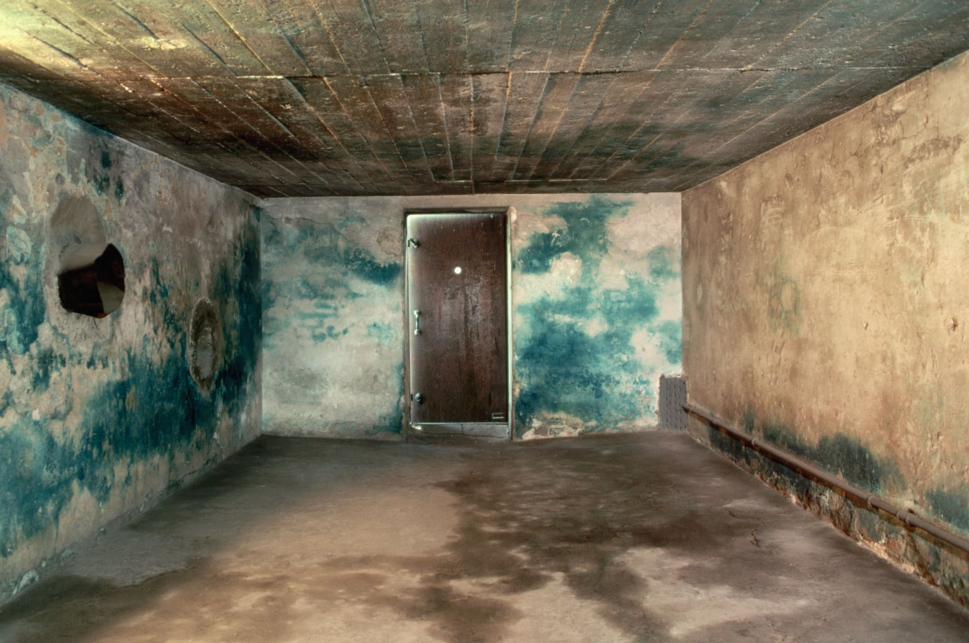
Notes:
Gas chamber, at Mojdanek
Zyklon B (pellets dropped in through ceiling)

Slide 18
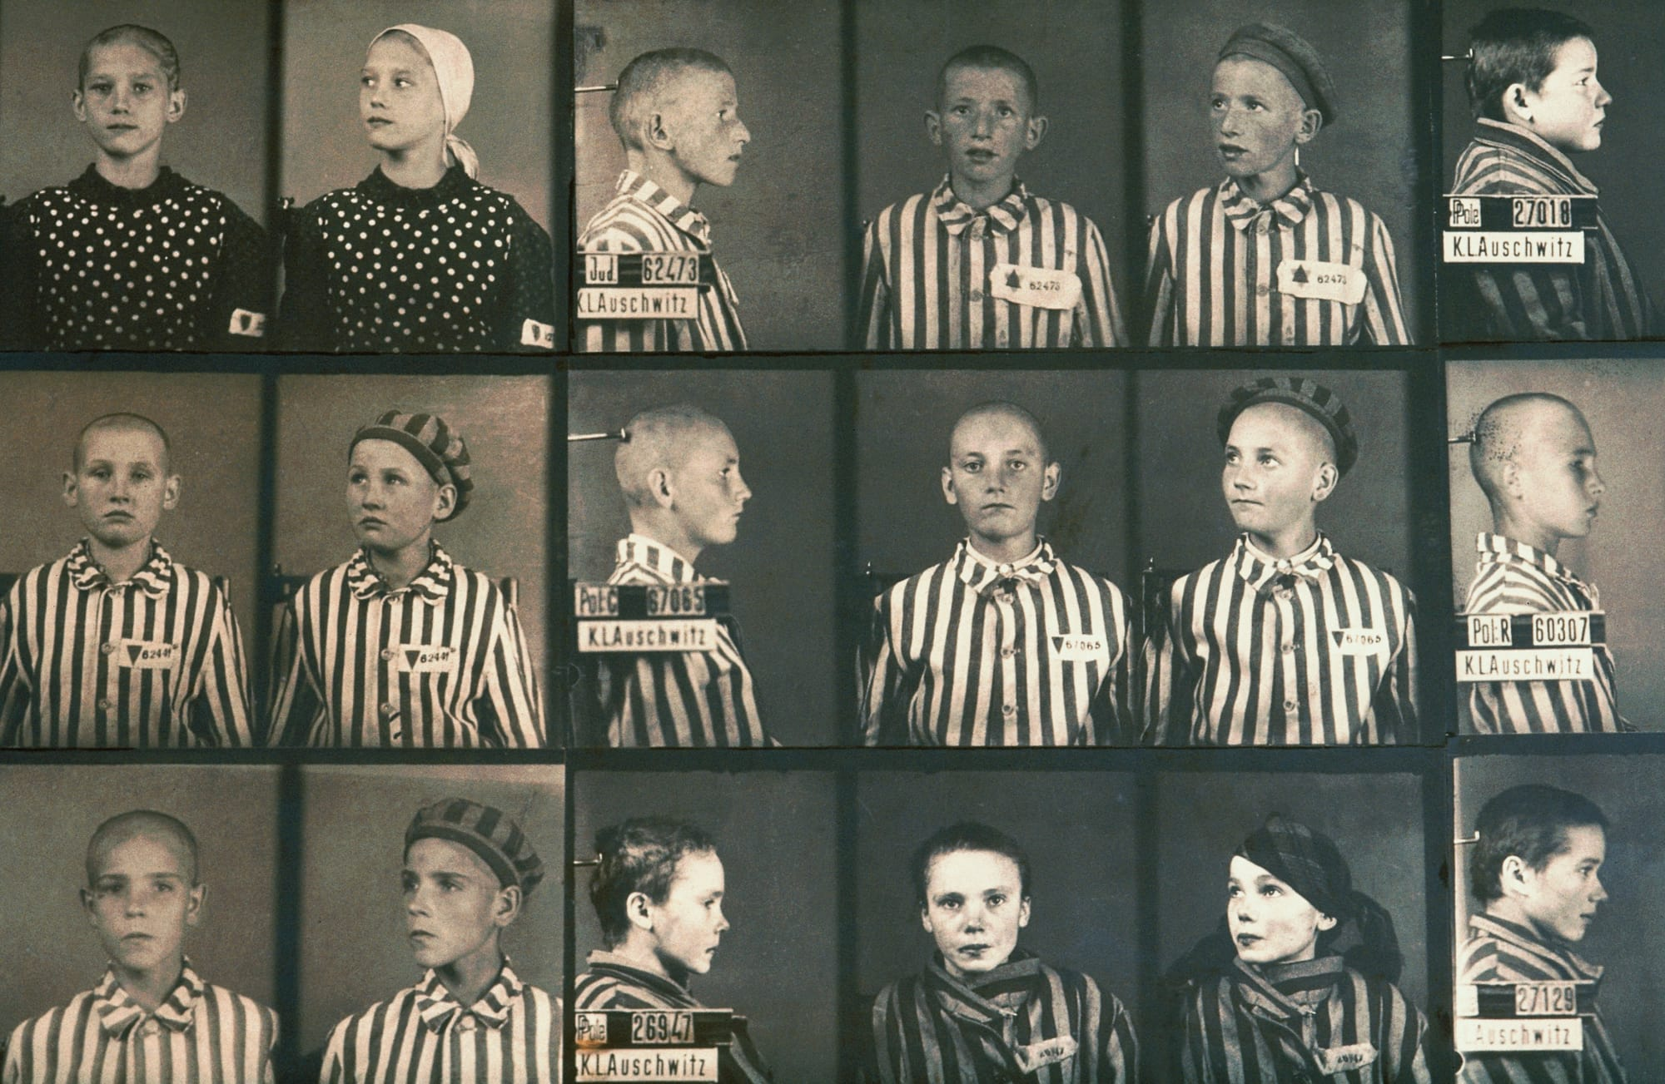
Notes:
Jewish children held at Auschwitz

Slide 19
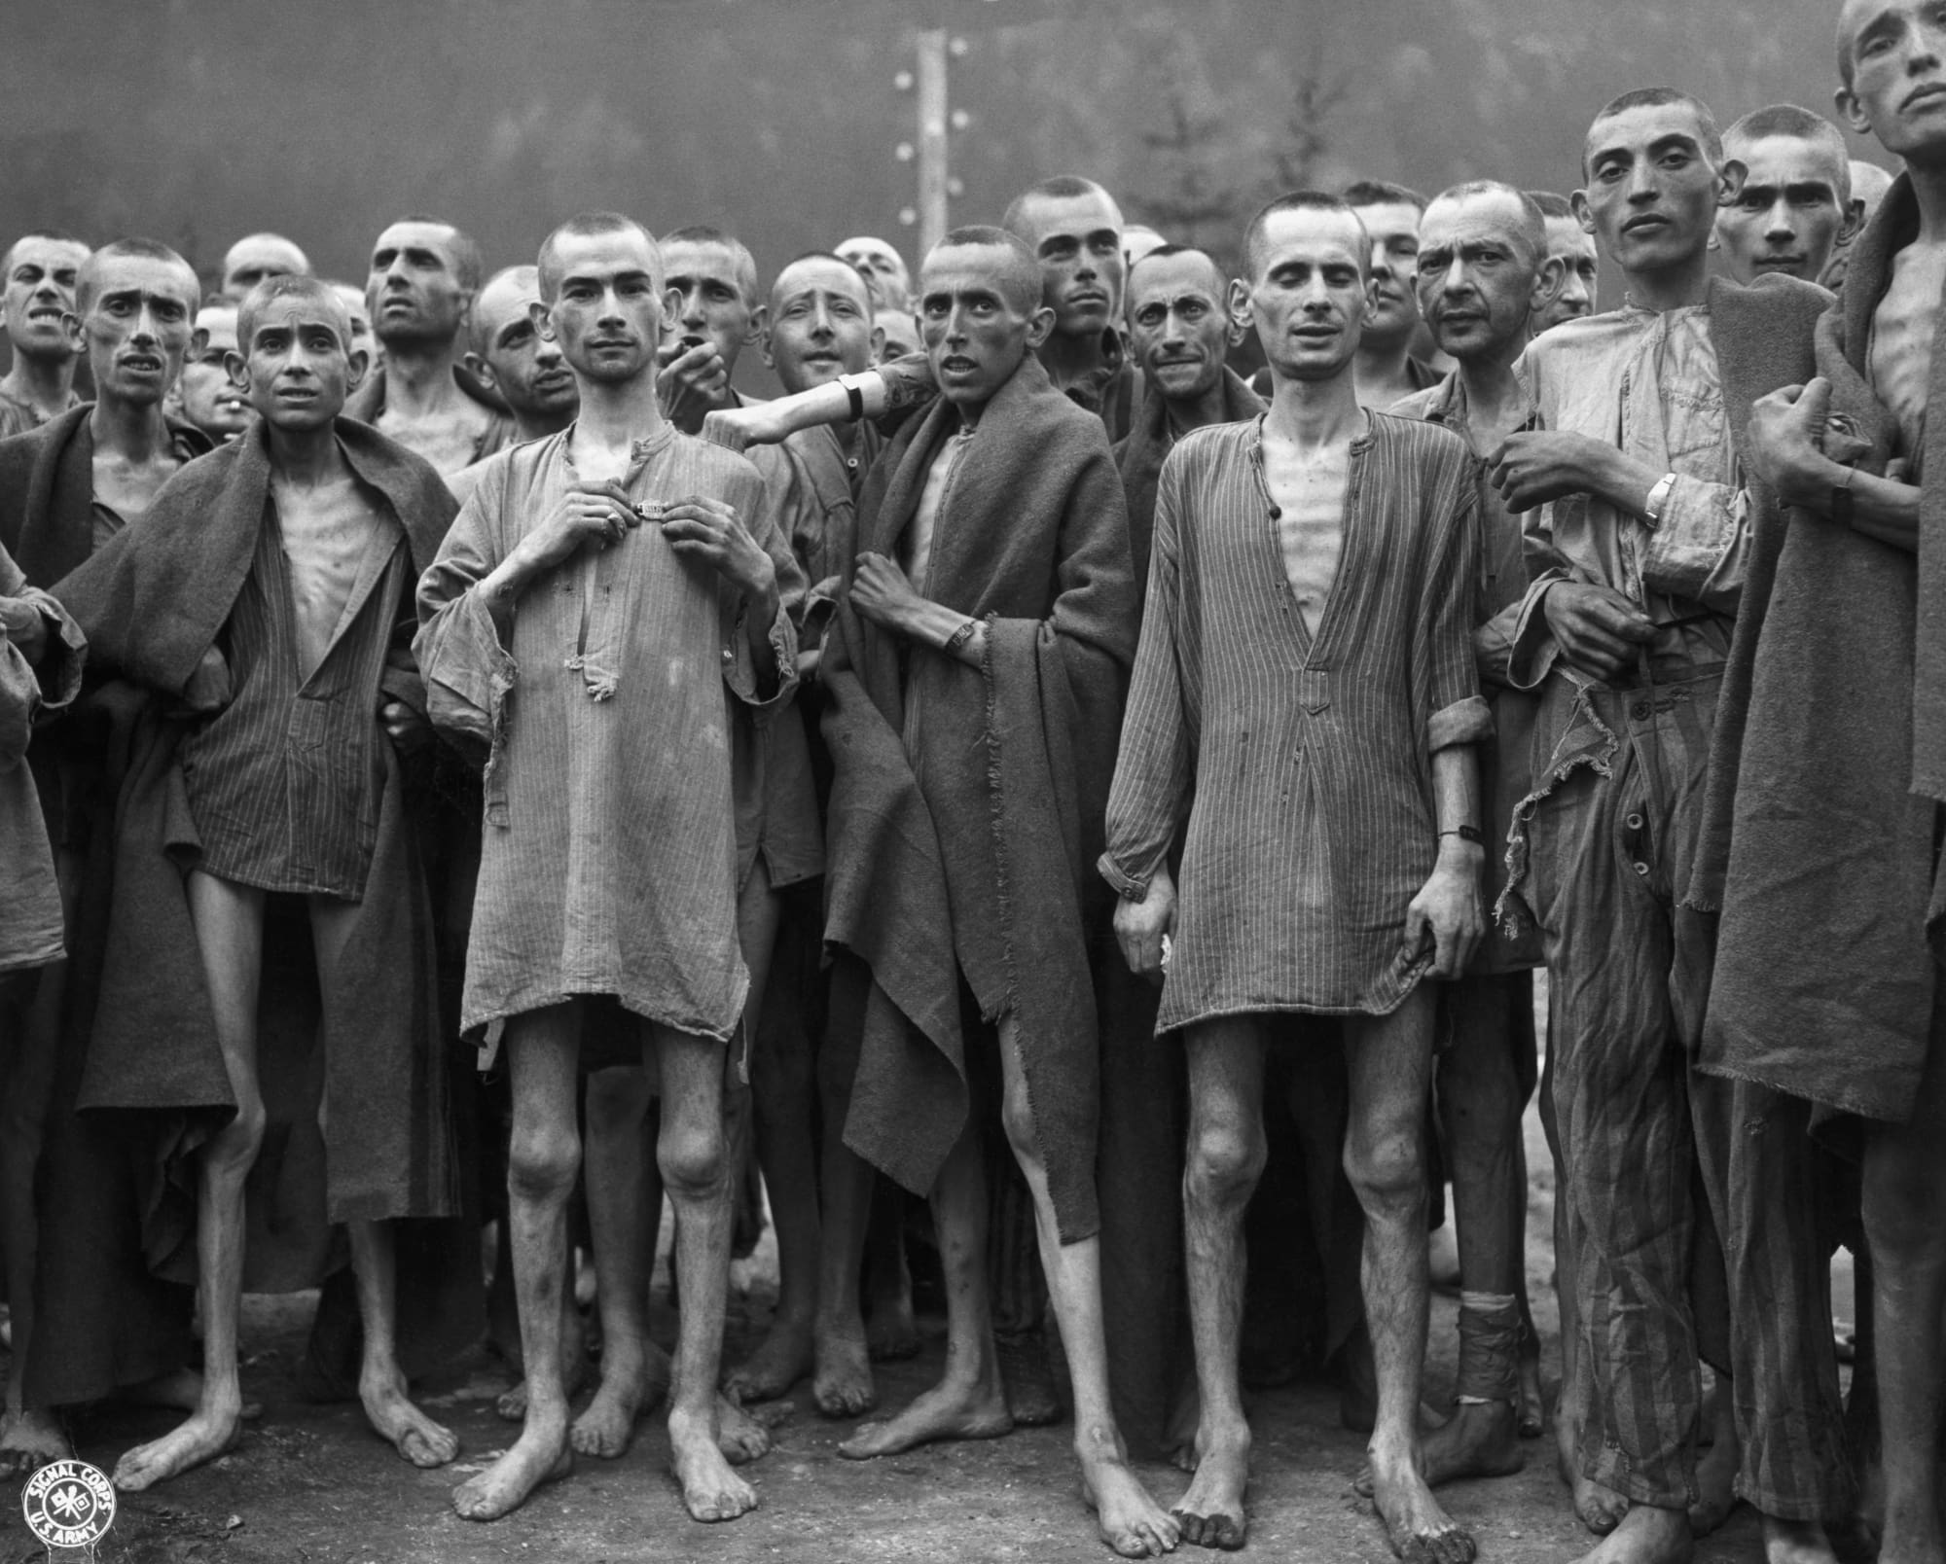
Notes:
Ebensee, Austria
Slave Labor camp built tunnels for weapons storage
May 7, 1945 a few days after liberation

Slide 20
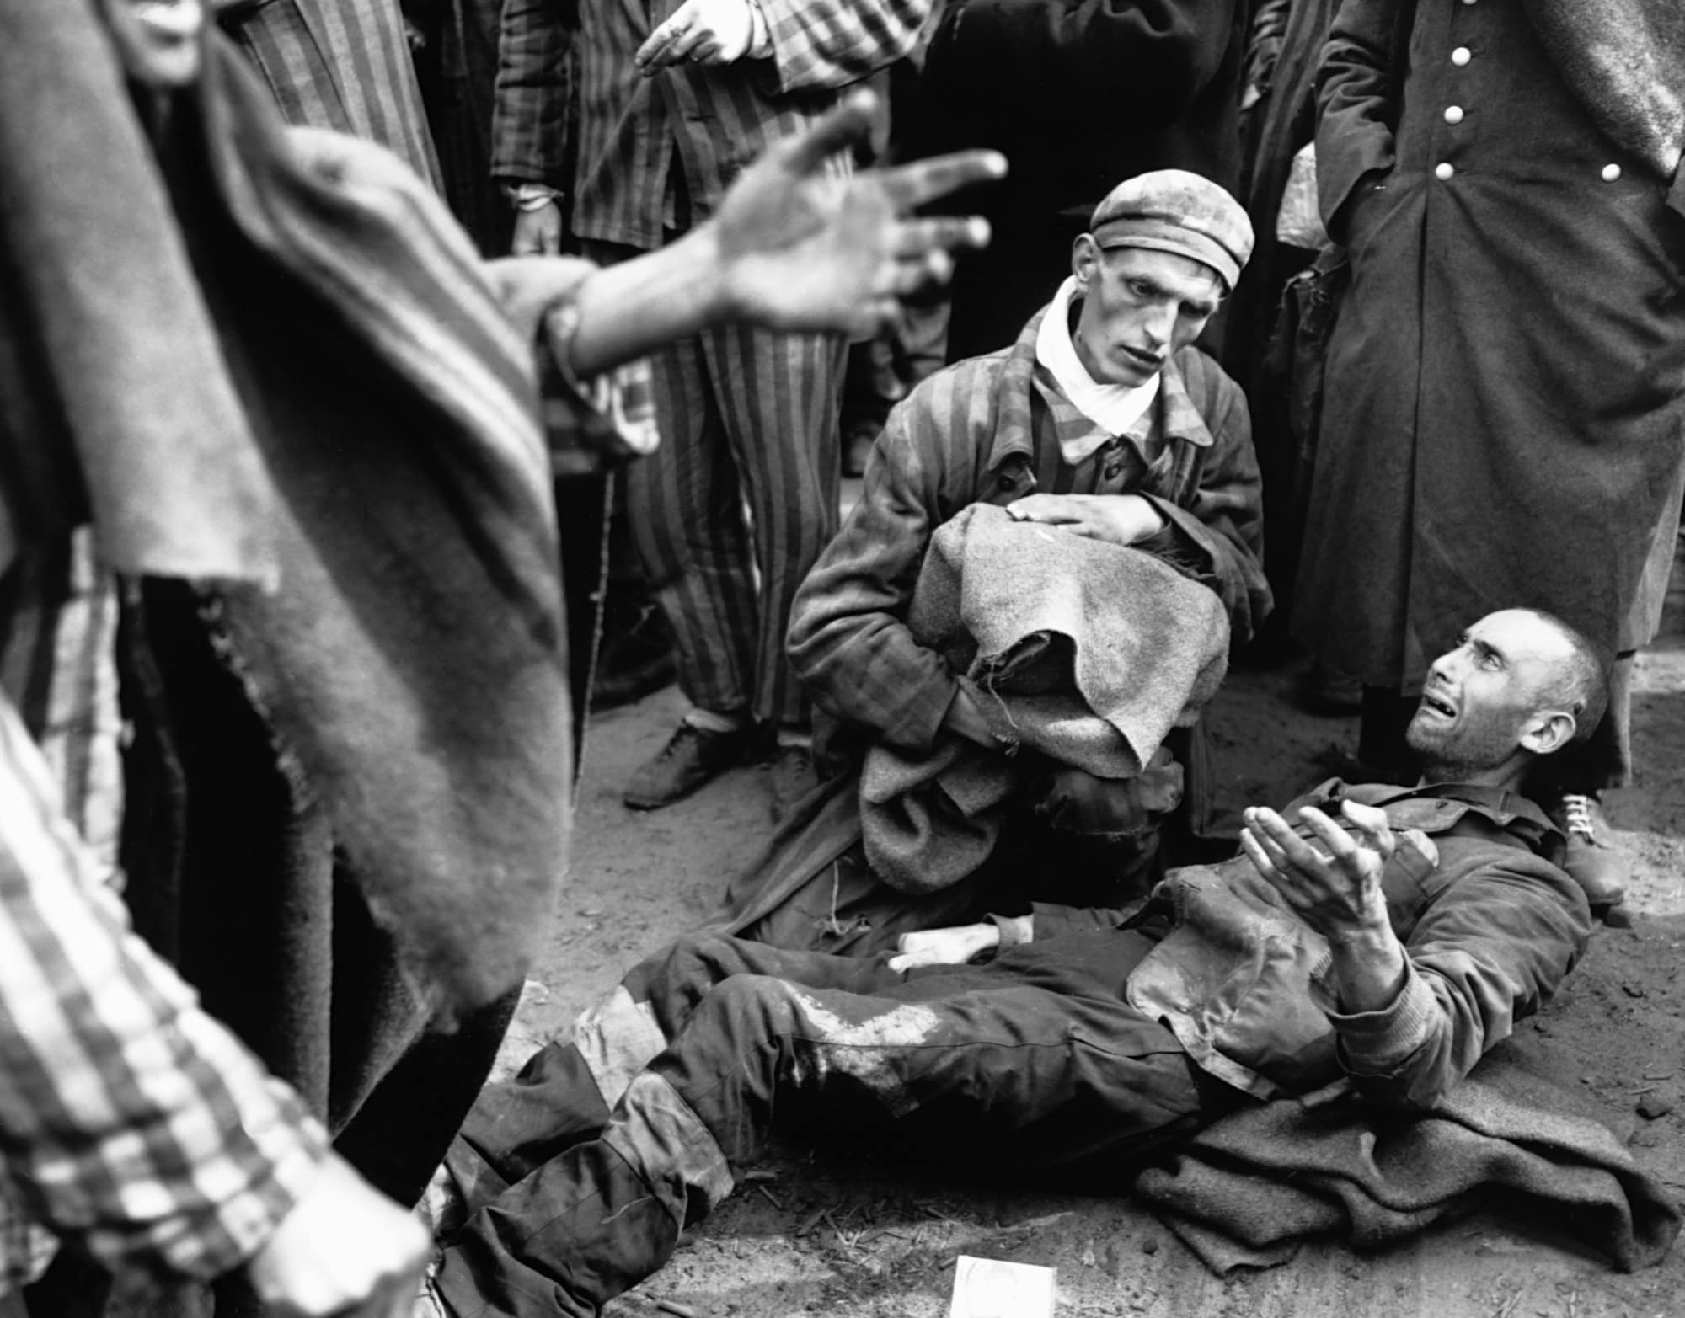
Notes:
May, 1945
Wobbelin camp, north Germany
Man is crying b/c not in first group to be taken to the hospital

Slide 21
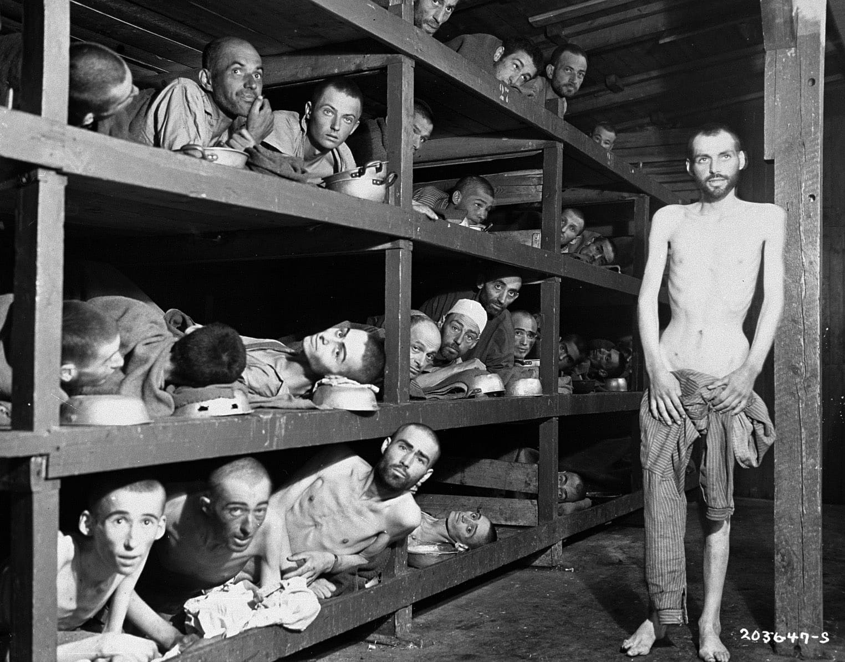
Notes:
Survivors at Buchenwald, Germany, April, 1945
Elie Viesel, Nobel Prize Winner, 7th from left on second bunk from bottom

Slide 22
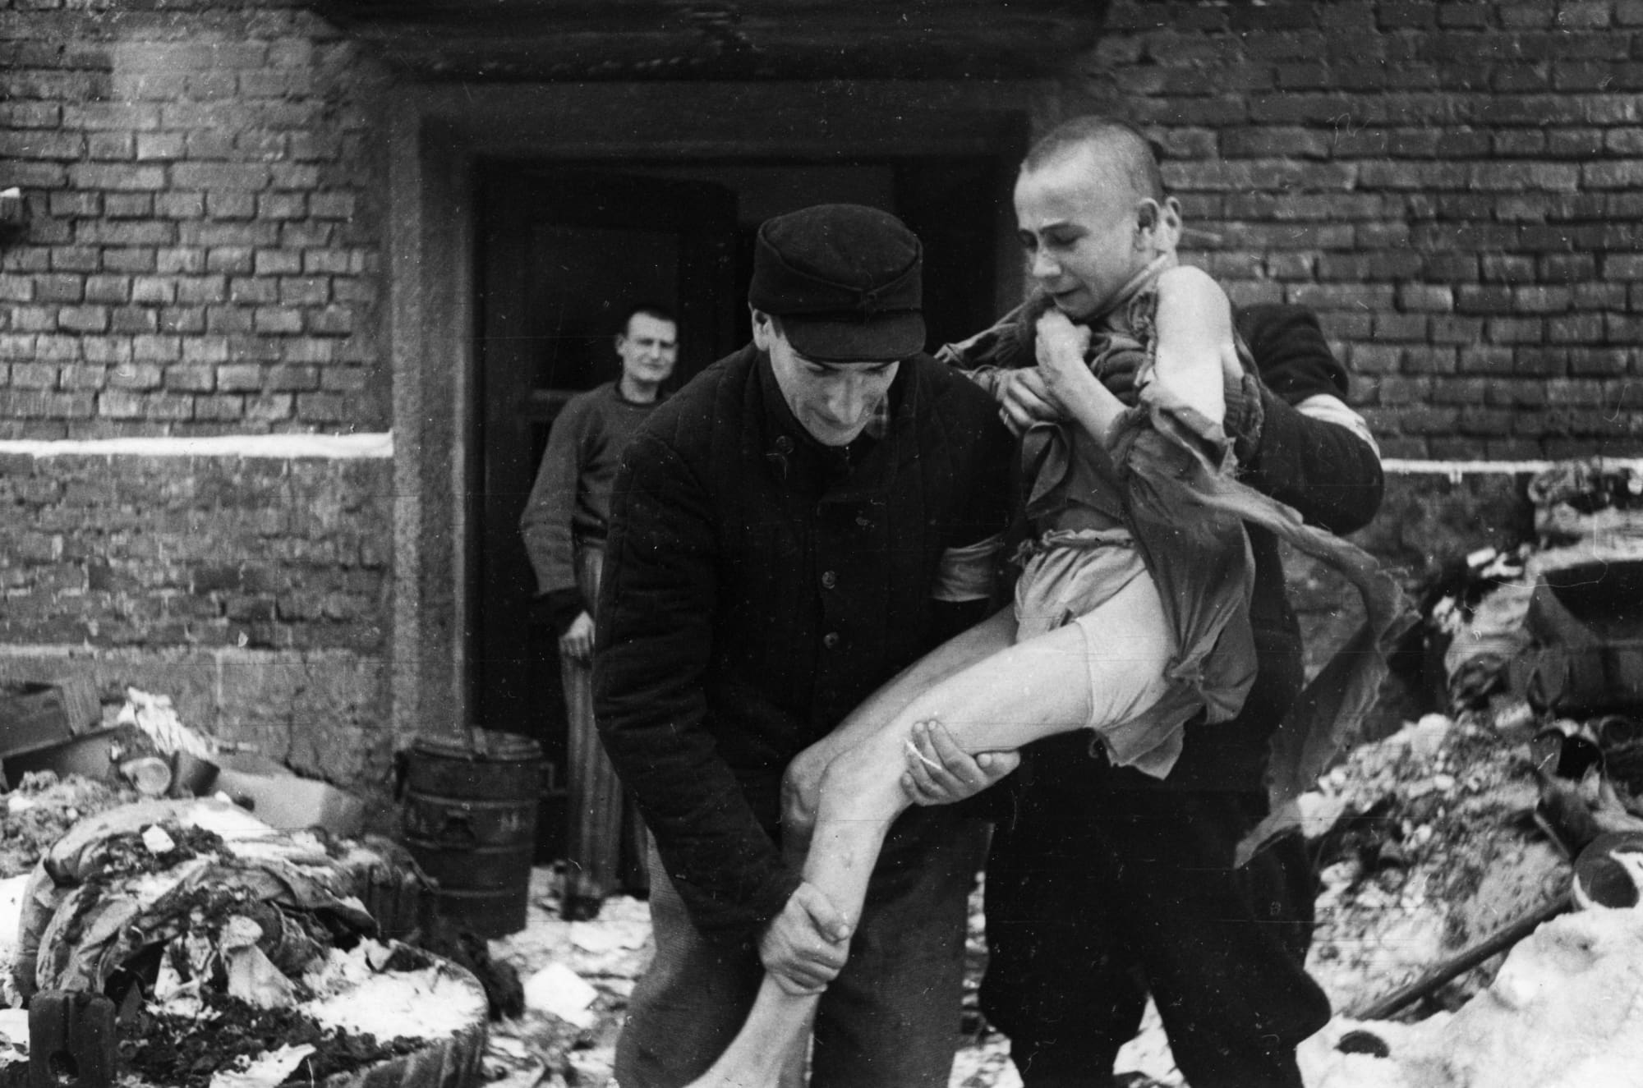
Notes:
15 year old Russian, being liberated, believed to have gone insane from what he saw

Slide 23
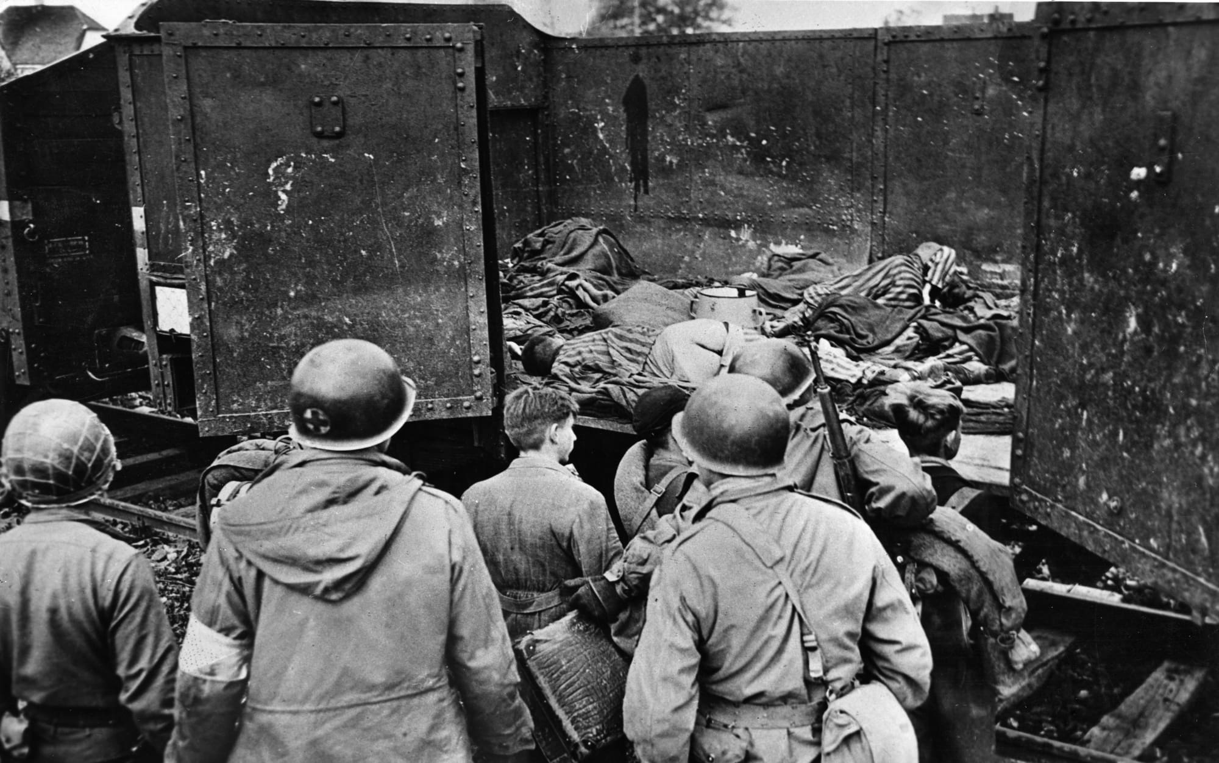
Notes:
Allies find victims in a railroad car, near Wobbelin camp, Germany

Slide 24
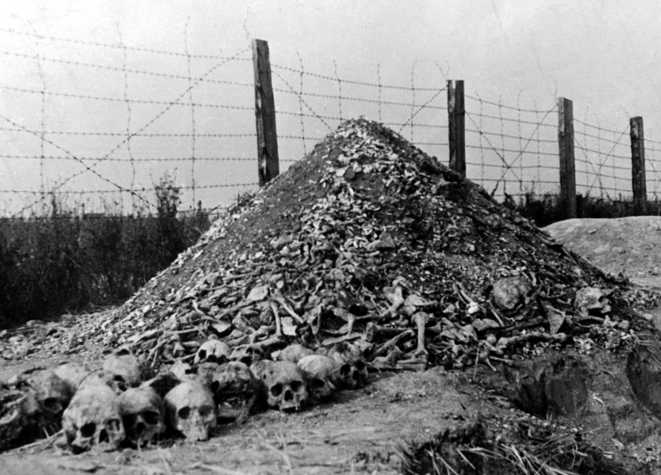
Notes:
Majdanek, Poland 2nd largest death camp
Pile of human remains

Slide 25
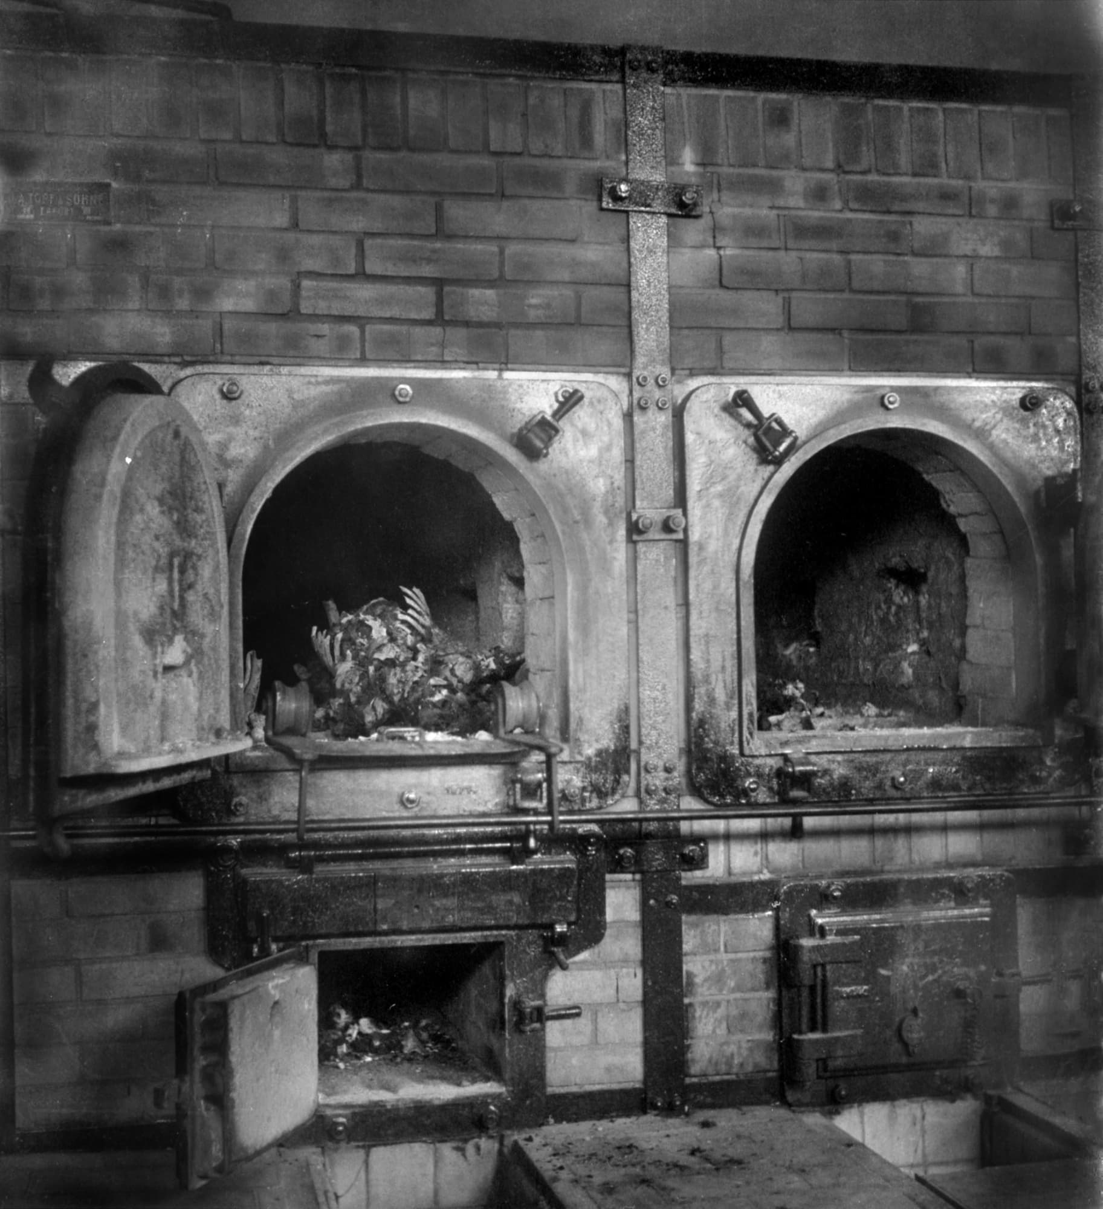
Notes:
Body in the crematory, April 1945

Slide 26
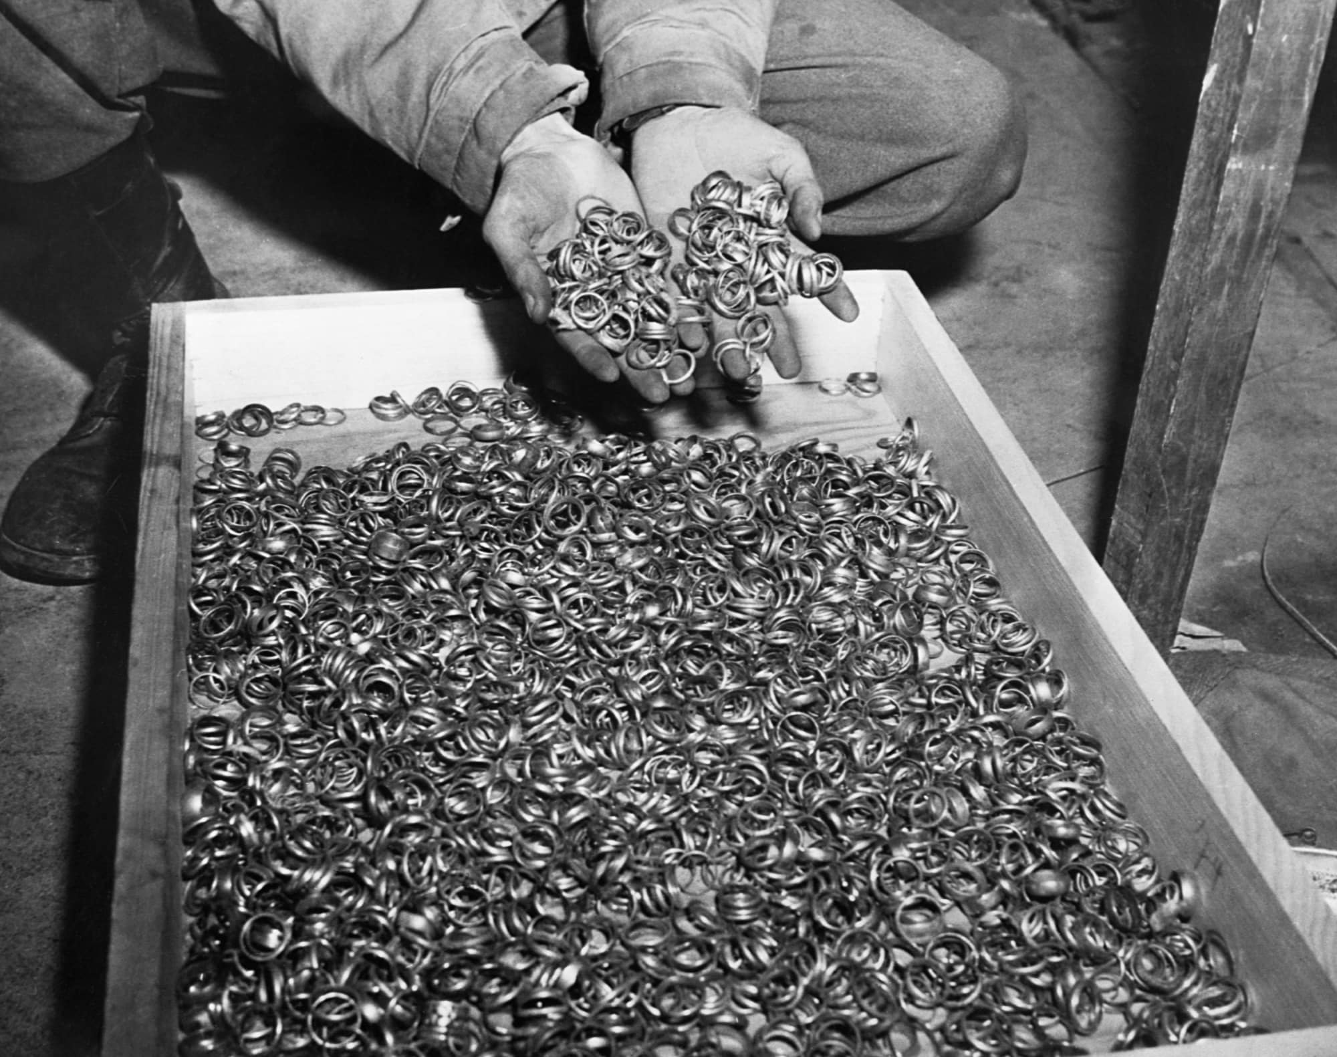
Notes:
Found in cave near the Buchenwald camp….rings, watches, eyeglasses, gold teeth fillings, found… kept to salvage the gold

Slide 27
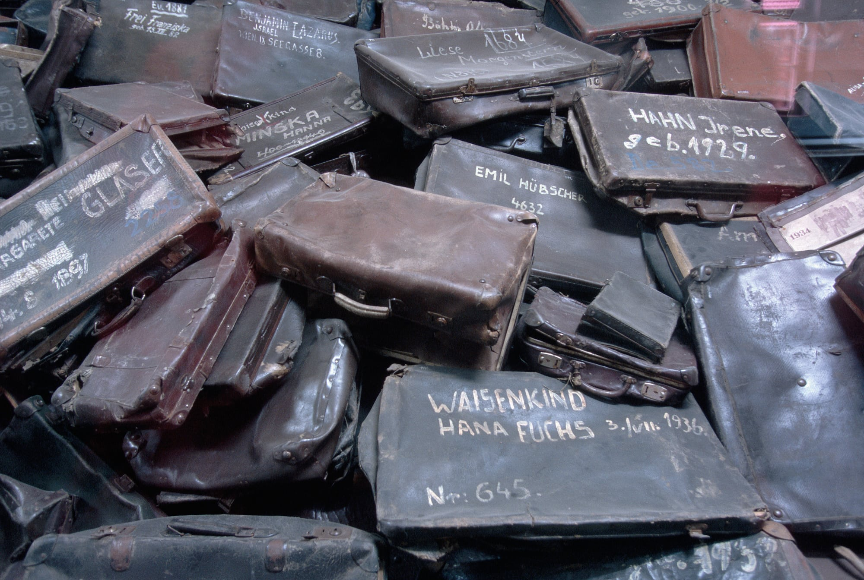
Notes:
Suitcases, incscribed with names, taken…

Slide 28
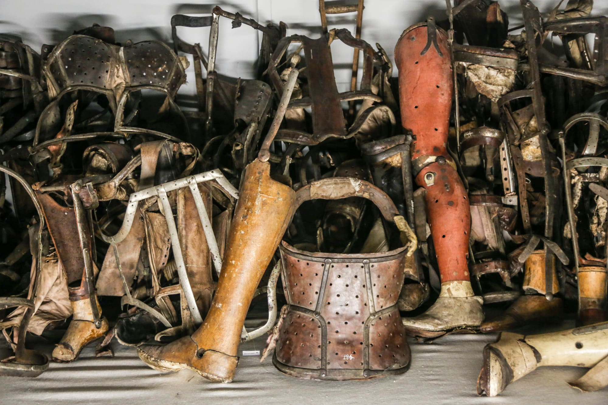
Notes:
There were laws against disabled people having children
Approx. 275,000 disabled people murdered by end of the war

Slide 29
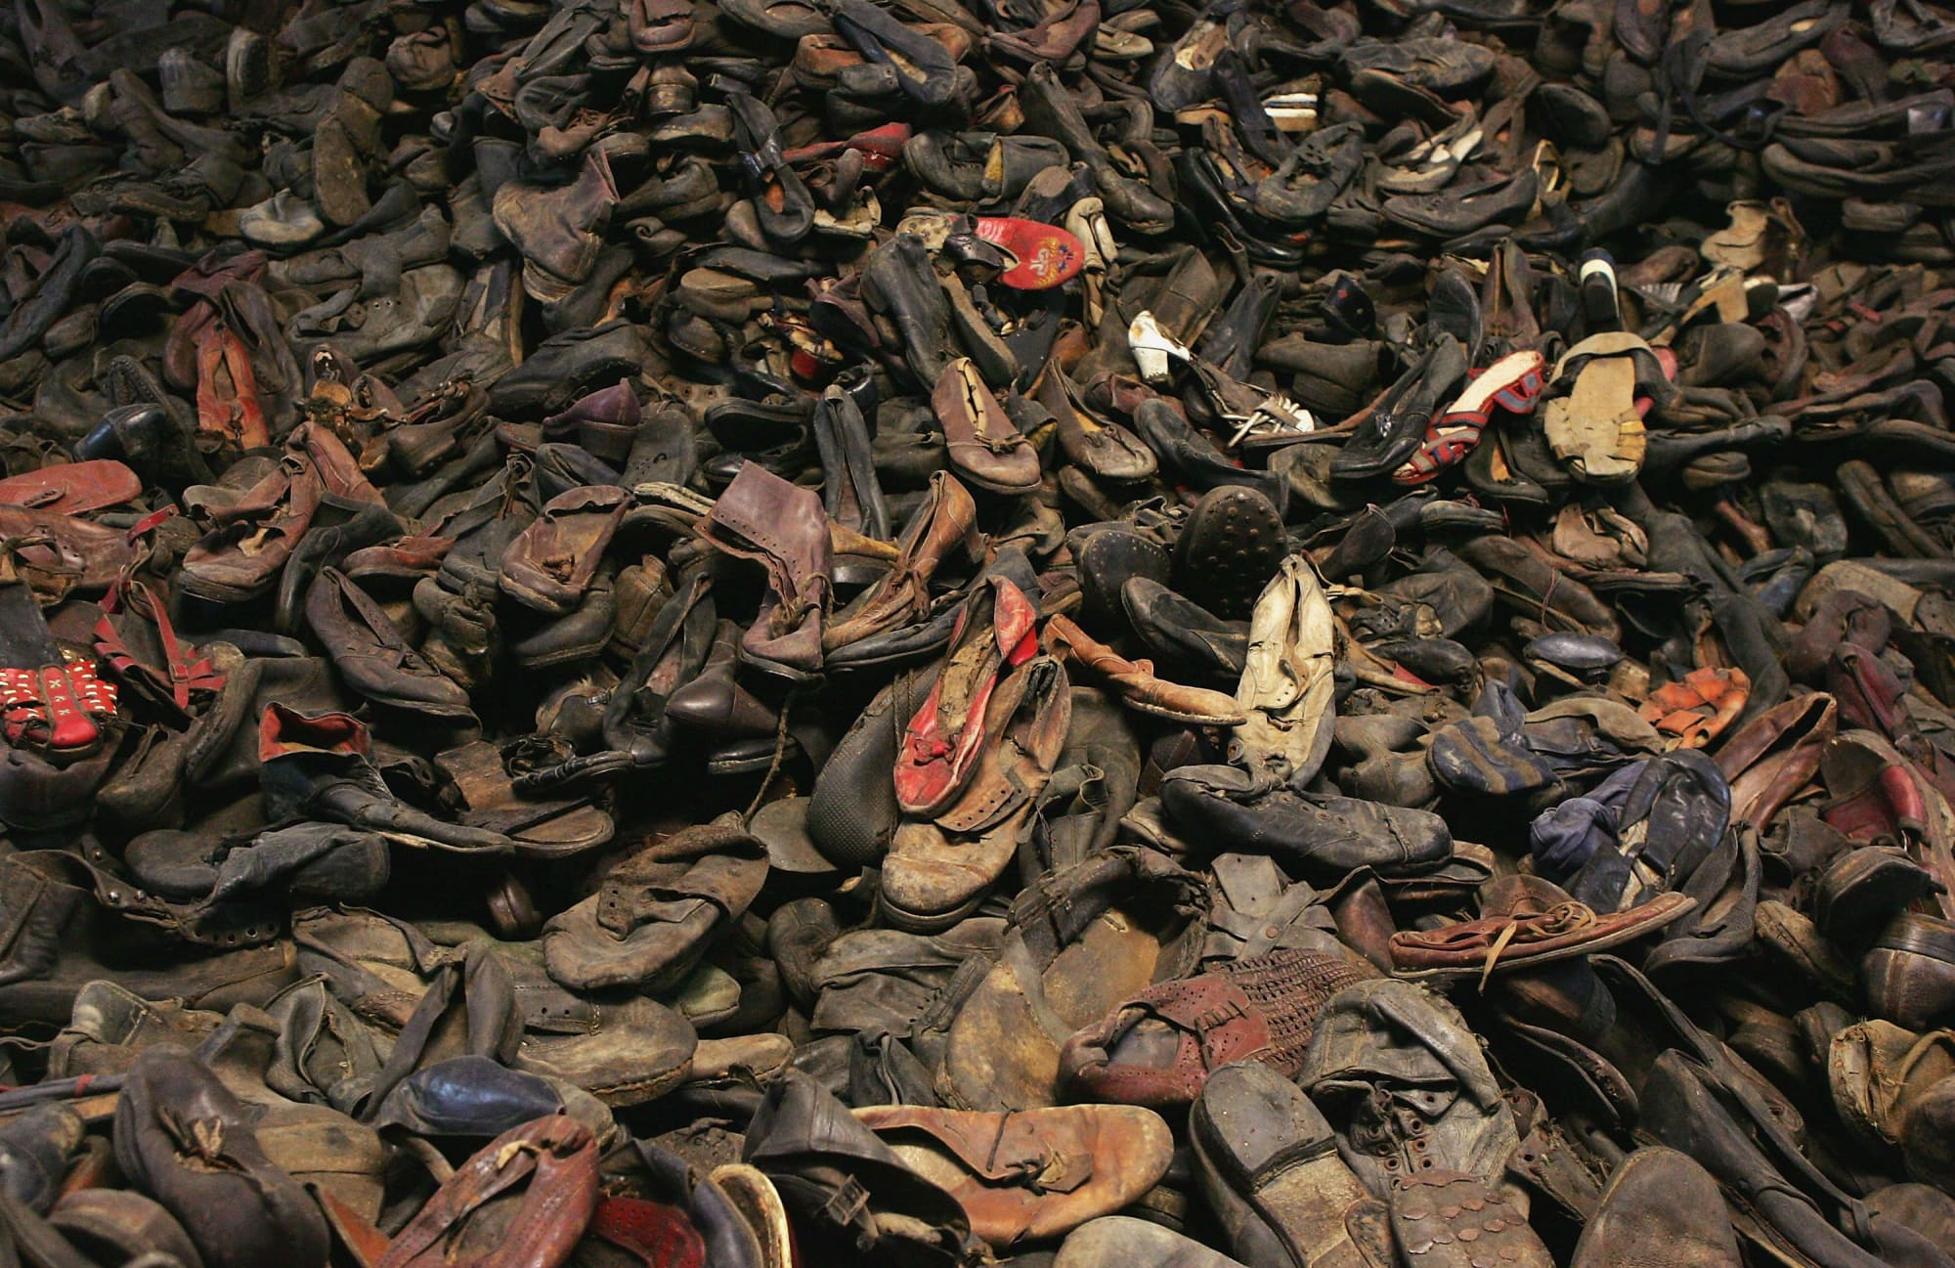
Notes:
Footwear from Auschwitz

